Slide 1
Introduction to Cloud Computing

Slide 2
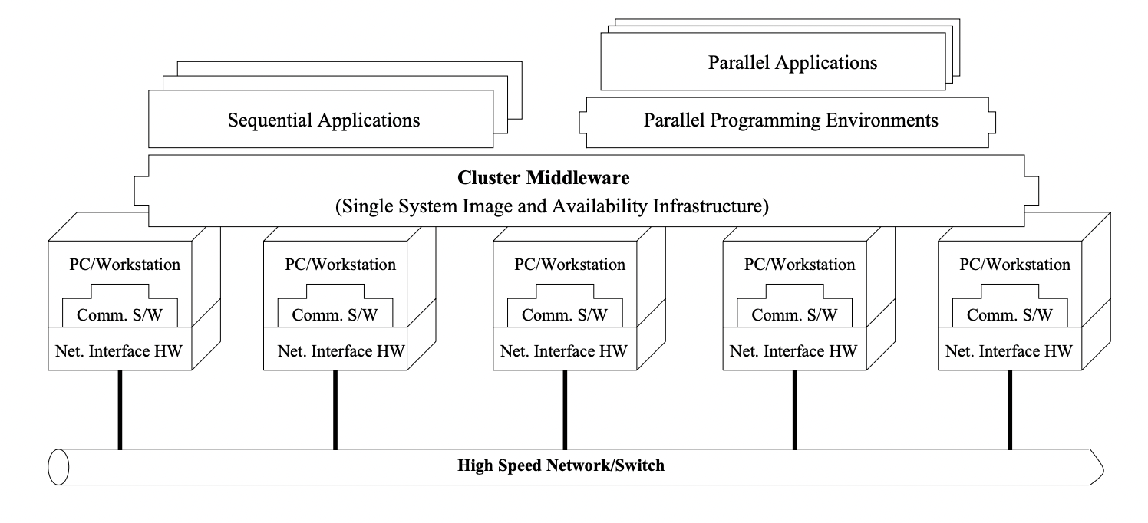
A cluster is a type of parallel or distributed processing system which consists of a collection of interconnected standalone computers working together as a single integrated computing resource. A computer node can be a single or multiprocessor system PCs workstations with memory IO facilities and an operating system A cluster generally refers to two or more computers nodes connected together in a single cabinet or be physically separated and connected via a LAN An inter connected LAN based cluster of computers can appear as a single system to users and applications Such a system can provide a cost effective way to gain features and benefits fast and reliable services that have historically been found only on more expensive proprietary shared memory systems.
Cluster Computing

Slide 3
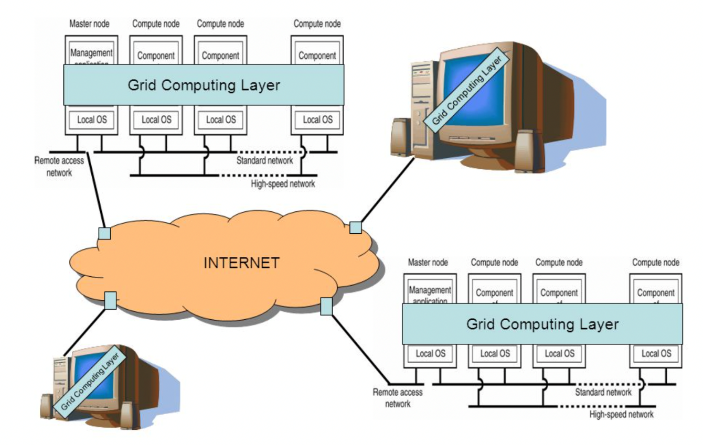
Grid computing combines computers from multiple administrative domains to reach a common goal, to solve a single task, and may then disappear just as quickly. It is similar to the power grid. One of the main strategies of grid computing is to use middleware to divide and apportion pieces of a program among several computers. Grid computing involves computation in a distributed fashion, which may also involve the aggregation of large-scale cluster computing based systems. The size of a grid may vary from small a network of computer workstations within a corporation to large collaborations across many companies and networks
Grid Computing

Slide 4
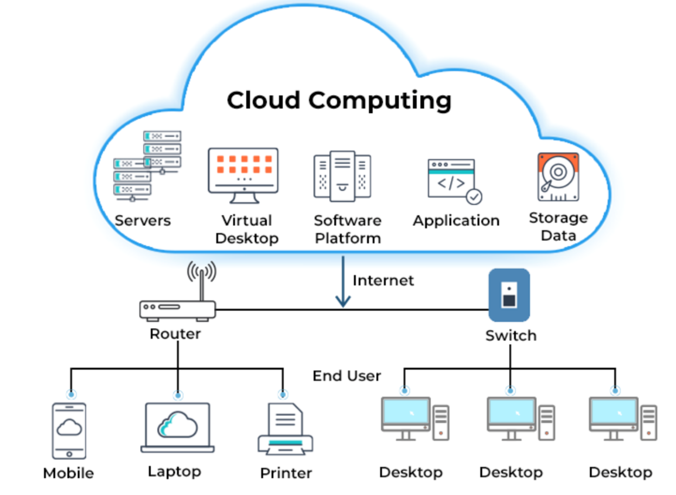
Cloud computing is a model for enabling convenient, on-demand network access to a shared pool of configurable computing resources (e.g., networks, servers, storage, applications, and services) that can be rapidly provisioned and released with minimal management effort or service provider interaction
Cloud Computing

Slide 5
Comparison
S.No. | Parameter | Cluster | Grid | Cloud
1 | Resource Handling | Centralized | Distributed | Both
2 | Scalability | Complex | Yes | Yes
3 | Reliability | No | Partial | Full
4 | Network Type | Private | Private | Public/ Internet
5 | Virtualization | Partial | Partial | Full
6 | Business Model | No | No | Yes
7 | Task size | Single large | Single large | Small, medium, large
8 | Heterogeneity | No | Yes | Yes
9 | Security | High | Medium-High | Low-High
10 | Cost | Very High | High | Low

Slide 6
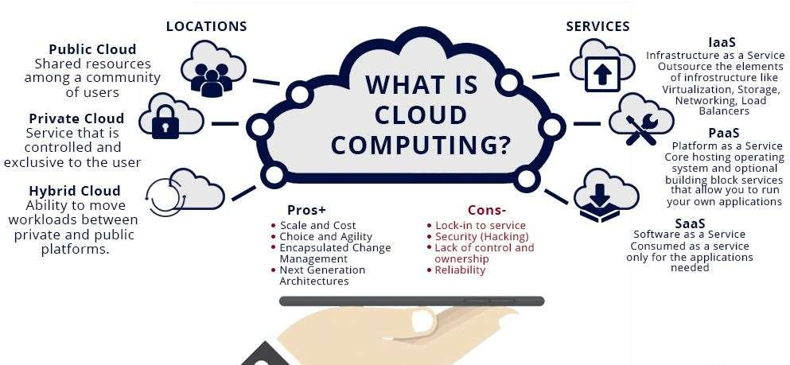
Cloud Computing Models, Resources, Attributes

Slide 7
Shared Resources and Resource Management:
Cloud uses a shared pool of resources.
Uses Internet techn. to offer scalable and elastic services.
The term “elastic computing” refers to the ability of dynamically and on-demand acquiring computing resources and supporting a variable workload.
Resources are metered and users are charged accordingly.
It is more cost-effective due to resource-multiplexing.
Cloud computing - Characteristics

Slide 8
Data Storage:
The data storage strategy can increase reliability, as well as security, and can lower communication costs.
Management:
The maintenance and security are operated by service providers.
The service providers can operate more efficiently due to specialisation and centralisation.
Cloud computing Characteristics
Shared Resources and Resource Management:
-Cloud uses a shared pool of resources.
-Uses Internet techn. to offer scalable and elastic services.
-The term “elastic computing” refers to the ability of dynamically and on-demand acquiring computing resources and supporting a variable workload.
-Resources are metered and users are charged accordingly.
-It is more cost-effective due to resource-multiplexing.

Slide 9
2. When multiple applications share a system, their peak demands for resources are not synchronized thus, multiplexing leads to a higher resource utilization.
1. Resources, such as CPU , storage, network bandwidth, are shared.
Cloud Computing Advantages
Resources can be aggregated to support data-
intensive applications.
Data sharing facilitates collaborative activities. Many applications require multiple types of analysis of shared data sets and multiple decisions carried out by groups scattered around the globe.

Slide 10
Eliminates the initial investment costs for a private computing infrastructure and the maintenance and operation costs.
Cost reduction: concentration of resources creates the opportunity to pay as you go for computing.
Elasticity: the ability to accommodate workloads
with very large peak-to-average ratios.
User convenience: virtualization allows users to operate in familiar environments rather than in idiosyncratic ones.
Cloud Computing Advantages

Slide 11
Public Cloud
The infrastructure is made available to the general public or a large industry group and is owned by the organization selling cloud services.
Private Cloud
The infrastructure is operated solely for an organization.
Hybrid Cloud
Composition of two or more Clouds (public, private, or community) as unique entities but bound by a standardised technology that enables data and application portability.
Other types: e.g., Community/Federated Cloud
The infrastructure is shared by several organizations and supports a community that has shared concerns.
Types of clouds

Slide 12
1. Availability of service: what happens when the service provider cannot deliver?
Data confidentiality , a serious problem.
Diversity of services, data organization, user interfaces available at different service providers limit user mobility; once a customer is hooked to one provider it is hard to move to another.
Data transfer bottleneck; many applications are
data-intensive.
Performance unpredictability, one of the consequences of resource sharing.
Resource management: It is a big challenge to manage different workloads running on large data centers. Are self-organization and self-management the solution?
Security and confidentiality: major concern for sensitive applications, e.g., healthcare applications.
Challenges for cloud computing

Slide 13



Cloud Computing Services

Slide 14





Cloud Computing (Service Models)

Slide 15
Service management and provisioning including
Virtualization.
Service provisioning.
Call center.
Operations management.
Systems management.
QoS management.
Billing and accounting, asset management.
SLA management.
Technical support and backups.
Cloud activities

Slide 16
Security management including:
ID and authentication.
Certification and accreditation.
intervention prevention.
intervention detection.
Virus protection.
Cryptography.
Physical security, incident response.
Access control, audit and trails, and firewalls.
Cloud activities (cont’d)

Slide 17
Customer services such as:
Customer assistance and on-line help.
Subscriptions.
Business intelligence.
Reporting.
Customer preferences.
Personalization.
Integration services including:
Data management.
Development.
Cloud activities (cont’d)

